Slide 1
CUANDO JESUS DIJO “NO”

Slide 2
ES DURO DECIR QUE “NO”
APRENDE A Decir no
Es decepcionante
"Sí" es una luz verde.
Preferiríamos decir "¡Claro, adelante!"
“Sí” es tolerancia, condonación y refuerzo.
"No" es lo contrario

Slide 3
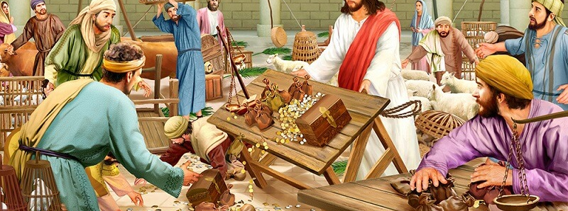
Cuando la gente está contaminando la casa de Dios
Cuando la adoración no es lo que debería ser
A los profanadores se les debe decir "no"
La levadura necesita a los purgados
Notes:
Mark 11:15-17 KJV And they come to Jerusalem: and Jesus went into the temple, and began to cast out them that sold and bought in the temple, and overthrew the tables of the moneychangers, and the seats of them that sold doves; (16) And would not suffer that any man should carry any vessel through the temple. (17) And he taught, saying unto them, Is it not written, My house shall be called of all nations the house of prayer? but ye have made it a den of thieves.
1 Corinthians 3:16-17 KJV Know ye not that ye are the temple of God, and that the Spirit of God dwelleth in you? (17) If any man defile the temple of God, him shall God destroy; for the temple of God is holy, which temple ye are.
1 Corinthians 5:6-7 KJV Your glorying is not good. Know ye not that a little leaven leaveneth the whole lump? (7) Purge out therefore the old leaven, that ye may be a new lump, as ye are unleavened. For even Christ our passover is sacrificed for us:

Slide 4
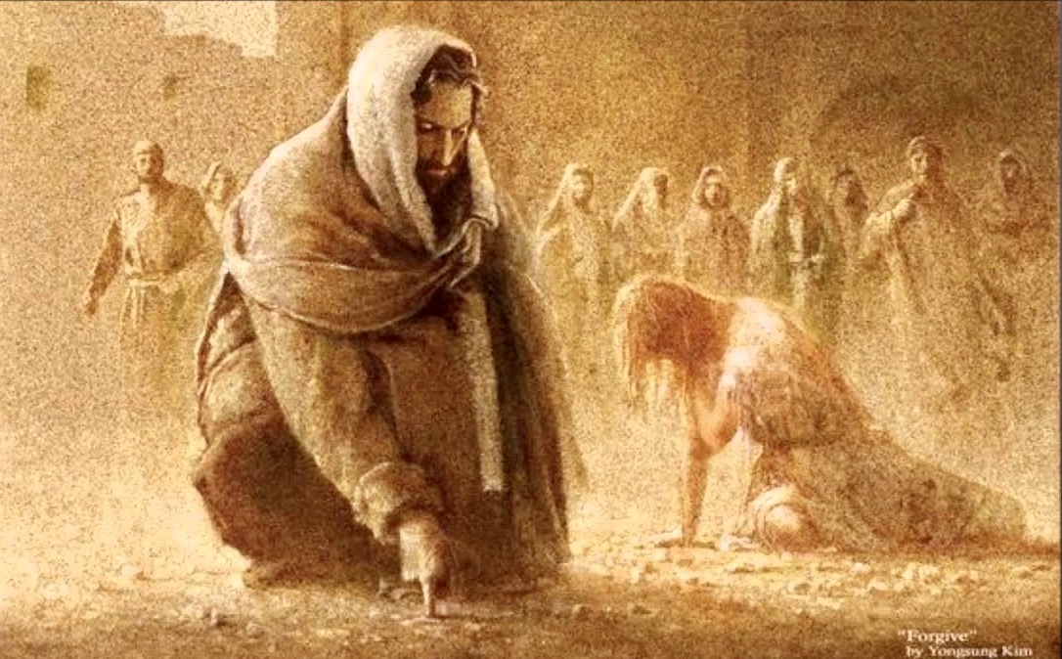
Cuando la gente solo quiere jugar con la verdad
Juan 8: 1-12
No trajeron al hombre
Solo querían probar a Jesús
Se inclinó y escribió en el suelo.
Notes:
John 8:1-11 KJV Jesus went unto the mount of Olives. (2) And early in the morning he came again into the temple, and all the people came unto him; and he sat down, and taught them. (3) And the scribes and Pharisees brought unto him a woman taken in adultery; and when they had set her in the midst, (4) They say unto him, Master, this woman was taken in adultery, in the very act. (5) Now Moses in the law commanded us, that such should be stoned: but what sayest thou? (6) This they said, tempting him, that they might have to accuse him. But Jesus stooped down, and with his finger wrote on the ground, as though he heard them not. (7) So when they continued asking him, he lifted up himself, and said unto them, He that is without sin among you, let him first cast a stone at her. (8) And again he stooped down, and wrote on the ground. (9) And they which heard it, being convicted by their own conscience, went out one by one, beginning at the eldest, even unto the last: and Jesus was left alone, and the woman standing in the midst. (10) When Jesus had lifted up himself, and saw none but the woman, he said unto her, Woman, where are those thine accusers? hath no man condemned thee? (11) She said, No man, Lord. And Jesus said unto her, Neither do I condemn thee: go, and sin no more.

Slide 5
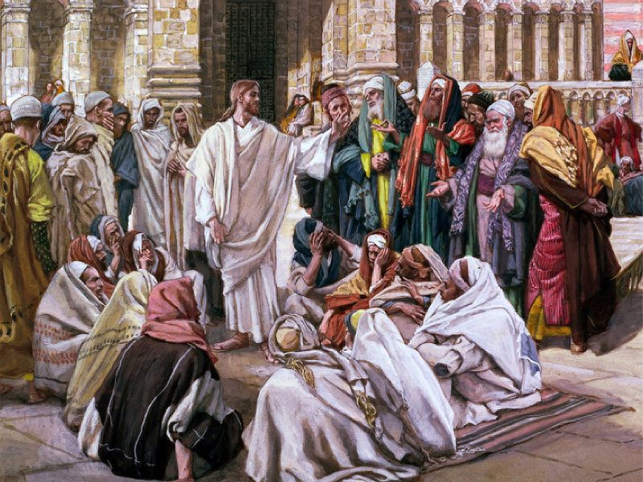
Cuando la Gente no esta siendo honesta
Mateo 21:23-27 ²³ Cuando vino al templo, los principales sacerdotes y los ancianos del pueblo se acercaron a él mientras enseñaba, y le dijeron: ¿Con qué autoridad haces estas cosas? ¿y quién te dio esta autoridad? ²⁴ Respondiendo Jesús, les dijo: Yo también os haré una pregunta, y si me la contestáis, también yo os diré con qué autoridad hago estas cosas. ²⁵ El bautismo de Juan, ¿de dónde era? ¿Del cielo, o de los hombres? Ellos entonces discutían entre sí, diciendo: Si decimos, del cielo, nos dirá: ¿Por qué, pues, no le creísteis? ²⁶ Y si decimos, de los hombres, tememos al pueblo; porque todos tienen a Juan por profeta. ²⁷ Y respondiendo a Jesús, dijeron: No sabemos. Y él también les dijo: Tampoco yo os digo con qué autoridad hago estas cosas.

Slide 6
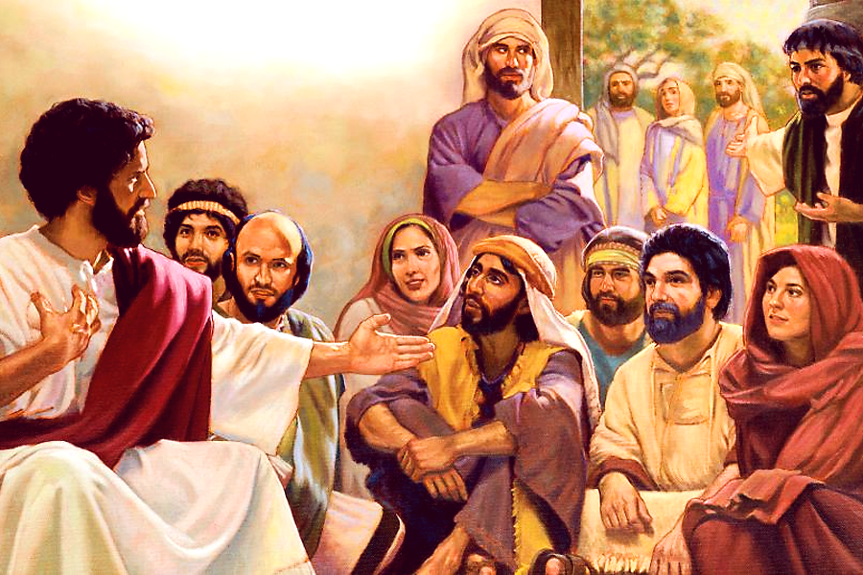
Cuando la familia nos aleja de la familia de Dios
Marcos 3:21; 31-35
Lucas 11: 27-28
2 Corintios 5: 16-17
Notes:
Mark 3:20-21 KJV And the multitude cometh together again, so that they could not so much as eat bread. (21) And when his friends heard of it, they went out to lay hold on him: for they said, He is beside himself.
Mark 3:31-35 KJV There came then his brethren and his mother, and, standing without, sent unto him, calling him. (32) And the multitude sat about him, and they said unto him, Behold, thy mother and thy brethren without seek for thee. (33) And he answered them, saying, Who is my mother, or my brethren? (34) And he looked round about on them which sat about him, and said, Behold my mother and my brethren! (35) For whosoever shall do the will of God, the same is my brother, and my sister, and mother.
Mark 3:21 NIV When his family heard about this, they went to take charge of him, for they said, "He is out of his mind."
Mark 3:31-35 NIV Then Jesus' mother and brothers arrived. Standing outside, they sent someone in to call him. (32) A crowd was sitting around him, and they told him, "Your mother and brothers are outside looking for you." (33) "Who are my mother and my brothers?" he asked. (34) Then he looked at those seated in a circle around him and said, "Here are my mother and my brothers! (35) Whoever does God's will is my brother and sister and mother."
Luke 11:27-28 NIV As Jesus was saying these things, a woman in the crowd called out, "Blessed is the mother who gave you birth and nursed you." (28) He replied, "Blessed rather are those who hear the word of God and obey it."
2 Corinthians 5:16-17 NASB (16) Therefore from now on we recognize no one according to the flesh; even though we have known Christ according to the flesh, yet now we know Him in this way no longer. (17) Therefore if anyone is in Christ, he is a new creature; the old things passed away; behold, new things have come.

Slide 7
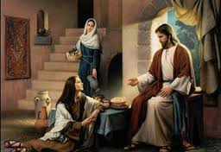
Cuando los cuidados de la vida nos llaman
Lucas10:38-42
Notes:
Luke 10:38-42 NASB Now as they were traveling along, He entered a village; and a woman named Martha welcomed Him into her home. (39) She had a sister called Mary, who was seated at the Lord's feet, listening to His word. (40) But Martha was distracted with all her preparations; and she came up to Him and said, "Lord, do You not care that my sister has left me to do all the serving alone? Then tell her to help me." (41) But the Lord answered and said to her, "Martha, Martha, you are worried and bothered about so many things; (42) but only one thing is necessary, for Mary has chosen the good part, which shall not be taken away from her."

Slide 8
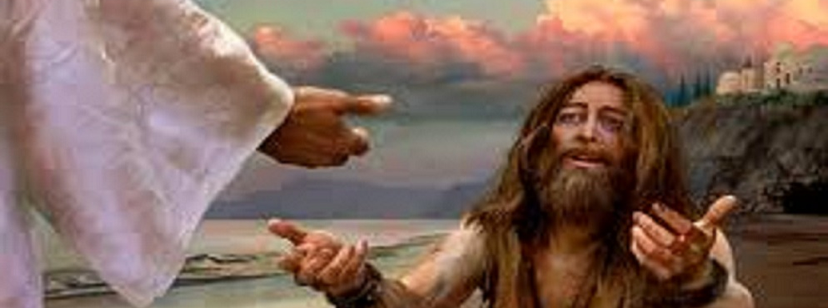
Cuando un hombre quiso estar con Jesús
Lucas 8: 26-39
Muchos querían que Jesús se fuera
Este hombre quería estar con él
Jesús dijo "No", vete a casa
Notes:
Luke 8:26-39 NASB Then they sailed to the country of the Gerasenes, which is opposite Galilee. (27) And when He came out onto the land, He was met by a man from the city who was possessed with demons; and who had not put on any clothing for a long time, and was not living in a house, but in the tombs. (28) Seeing Jesus, he cried out and fell before Him, and said in a loud voice, "What business do we have with each other, Jesus, Son of the Most High God? I beg You, do not torment me." (29) For He had commanded the unclean spirit to come out of the man. For it had seized him many times; and he was bound with chains and shackles and kept under guard, and yet he would break his bonds and be driven by the demon into the desert. (30) And Jesus asked him, "What is your name?" And he said, "Legion"; for many demons had entered him. (31) They were imploring Him not to command them to go away into the abyss. (32) Now there was a herd of many swine feeding there on the mountain; and the demons implored Him to permit them to enter the swine. And He gave them permission. (33) And the demons came out of the man and entered the swine; and the herd rushed down the steep bank into the lake and was drowned. (34) When the herdsmen saw what had happened, they ran away and reported it in the city and out in the country. (35) The people went out to see what had happened; and they came to Jesus, and found the man from whom the demons had gone out, sitting down at the feet of Jesus, clothed and in his right mind; and they became frightened. (36) Those who had seen it reported to them how the man who was demon-possessed had been made well. (37) And all the people of the country of the Gerasenes and the surrounding district asked Him to leave them, for they were gripped with great fear; and He got into a boat and returned. (38) But the man from whom the demons had gone out was begging Him that he might accompany Him; but He sent him away, saying, (39) "Return to your house and describe what great things God has done for you." So he went away, proclaiming throughout the whole city what great things Jesus had done for him.

Slide 9
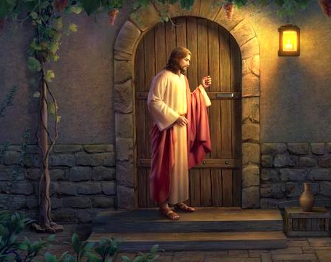
El Está Tocando
Que diras “si” o “no”
Notes:
Revelation 3:18-20 KJV I counsel thee to buy of me gold tried in the fire, that thou mayest be rich; and white raiment, that thou mayest be clothed, and that the shame of thy nakedness do not appear; and anoint thine eyes with eyesalve, that thou mayest see. (19) As many as I love, I rebuke and chasten: be zealous therefore, and repent. (20) Behold, I stand at the door, and knock: if any man hear my voice, and open the door, I will come in to him, and will sup with him, and he with me.

